Slide 1


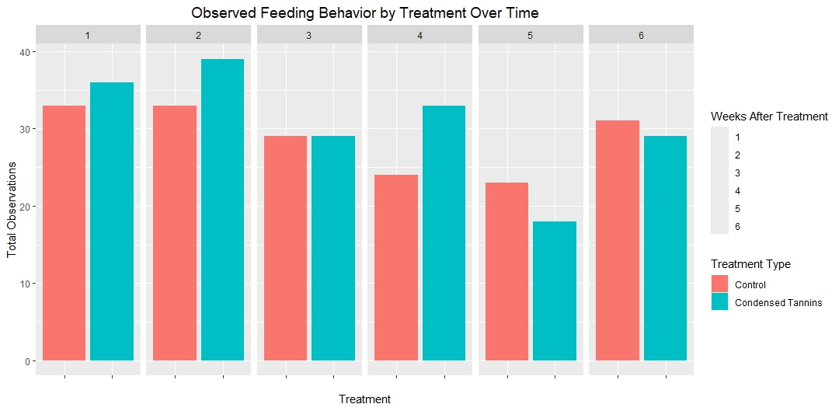
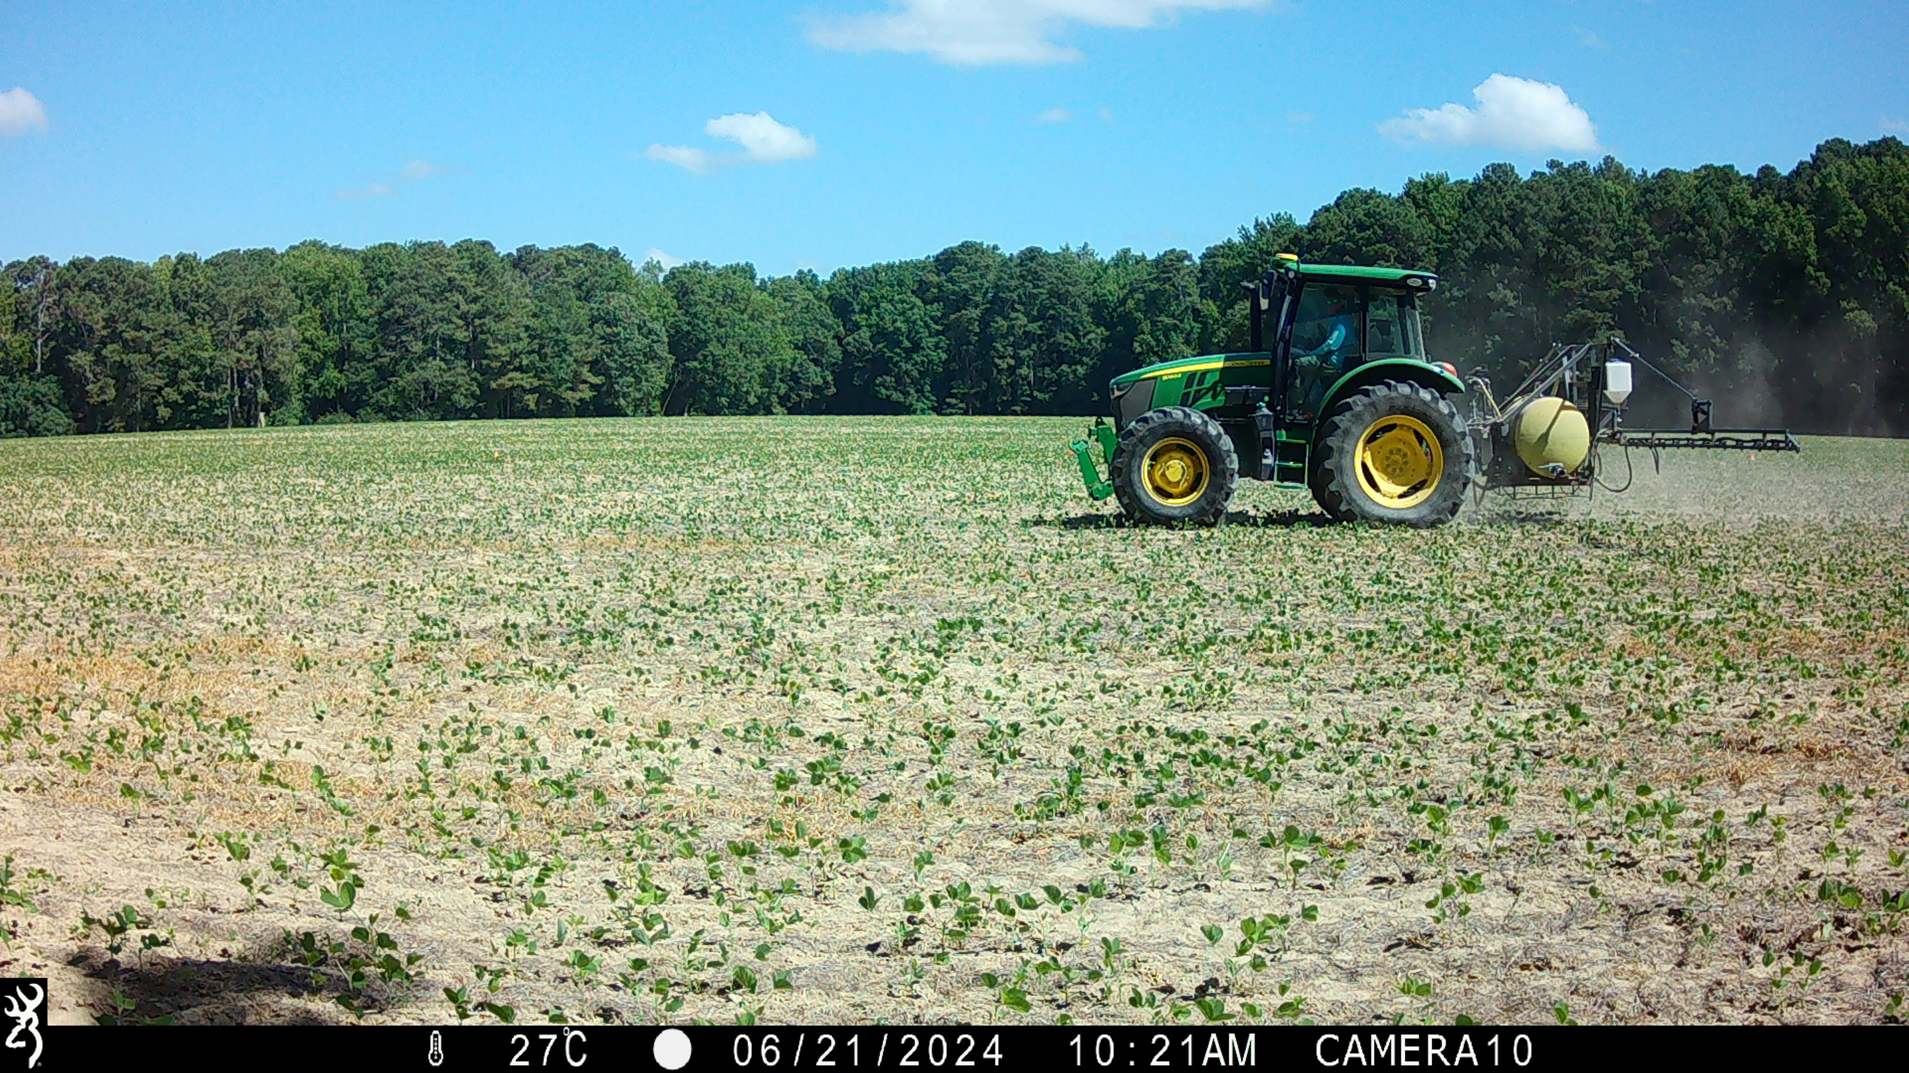
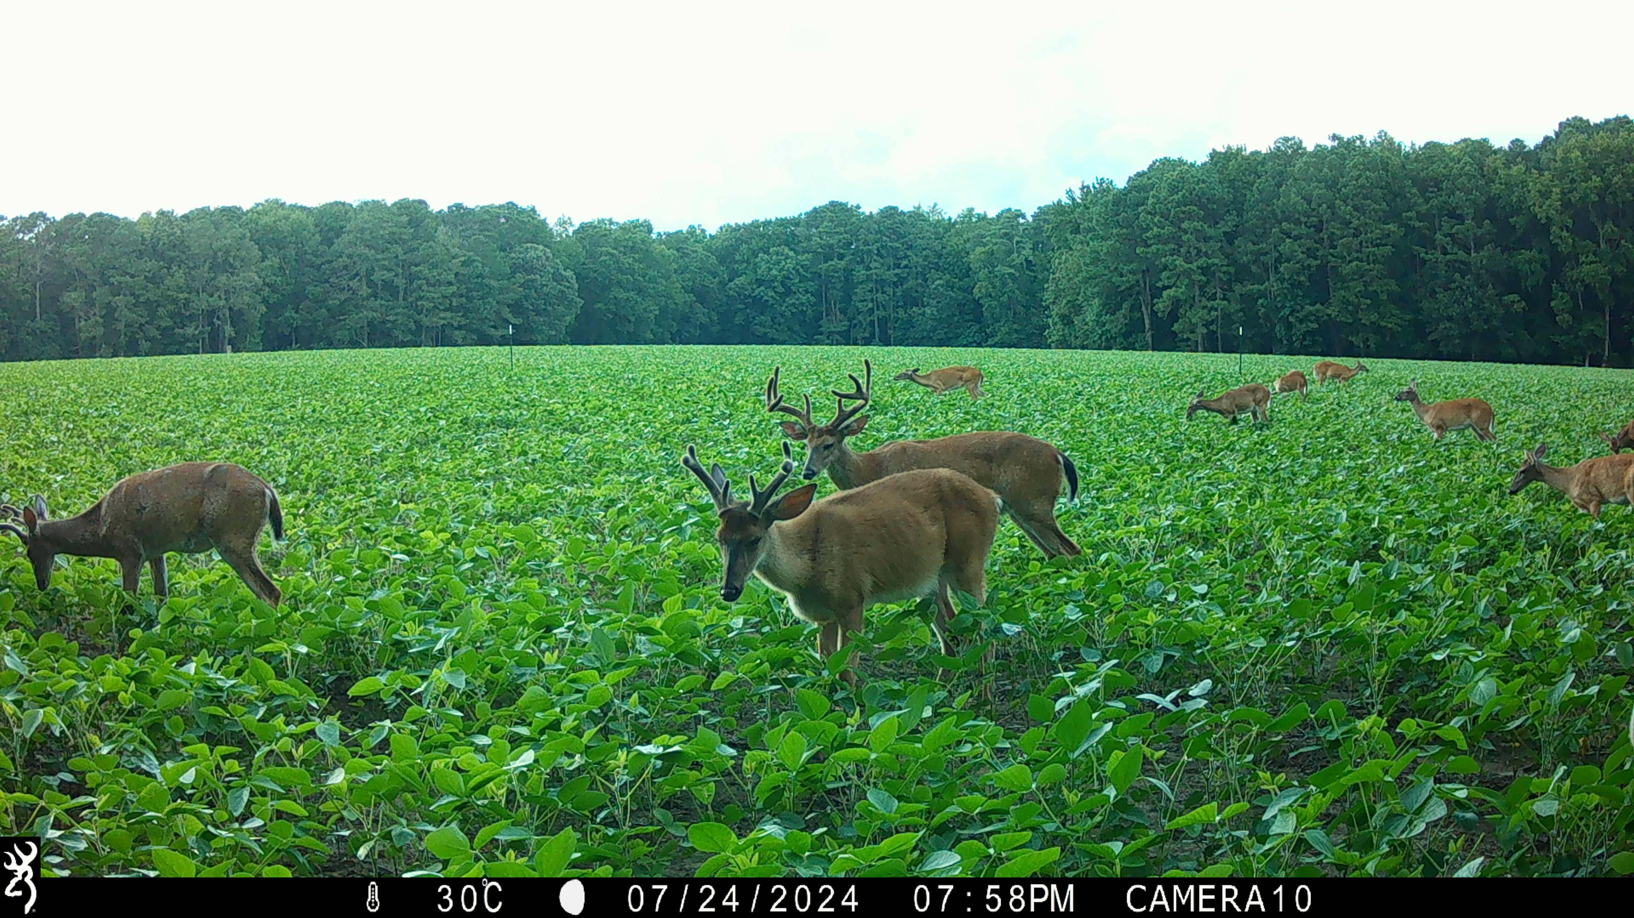
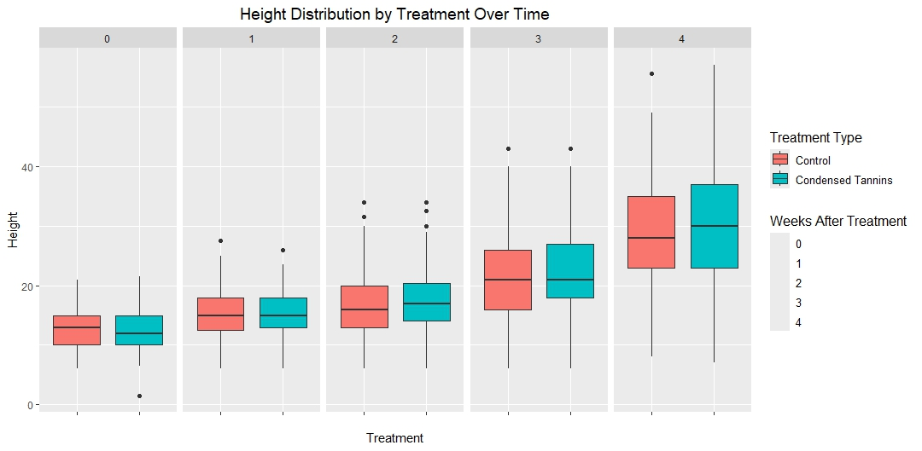
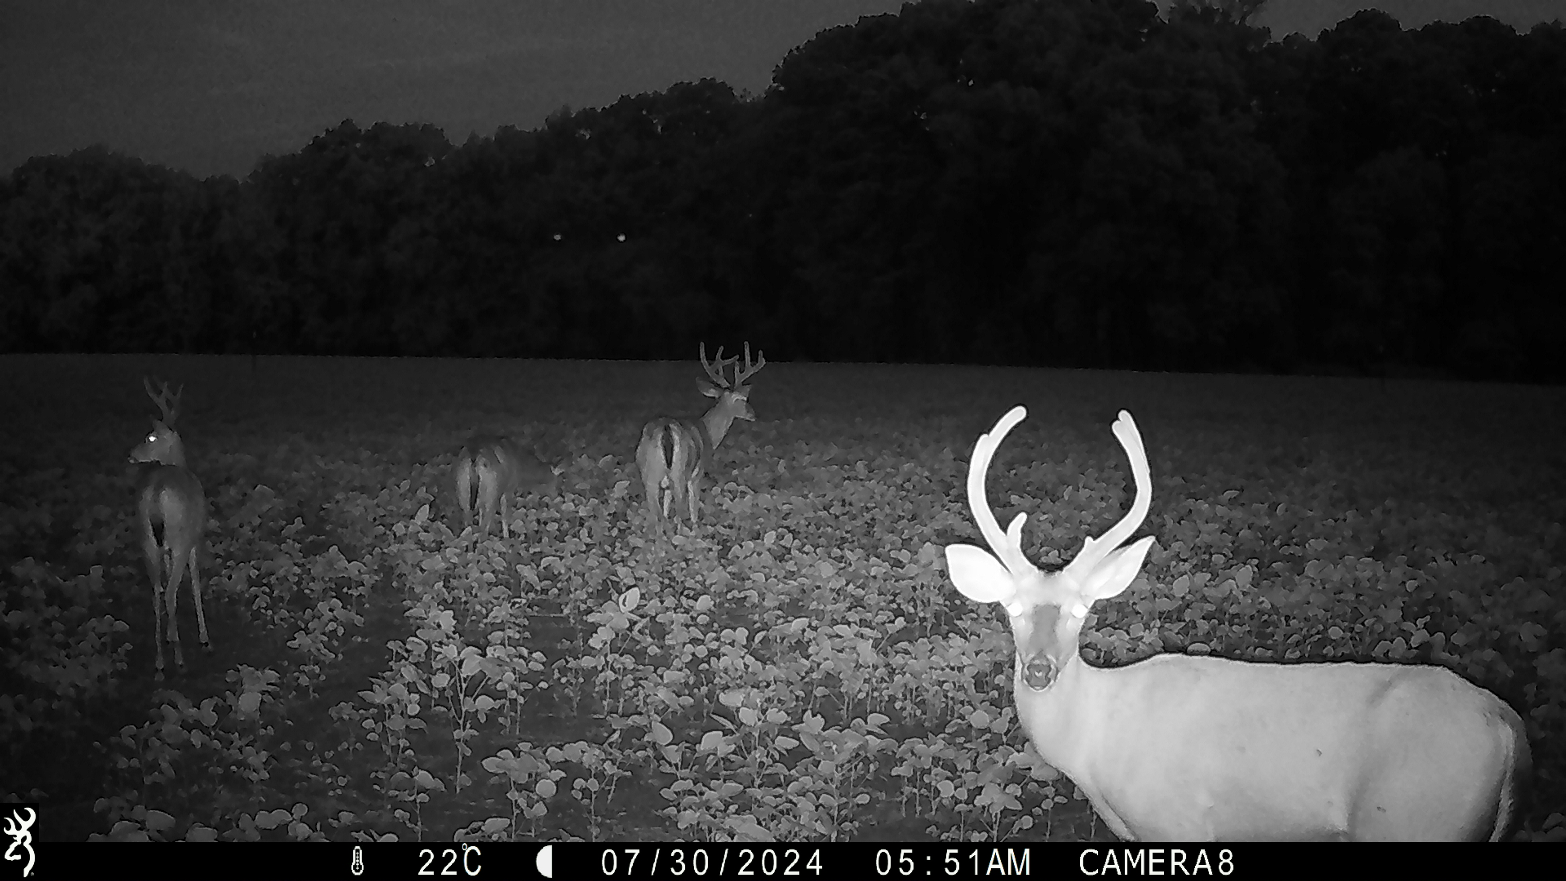
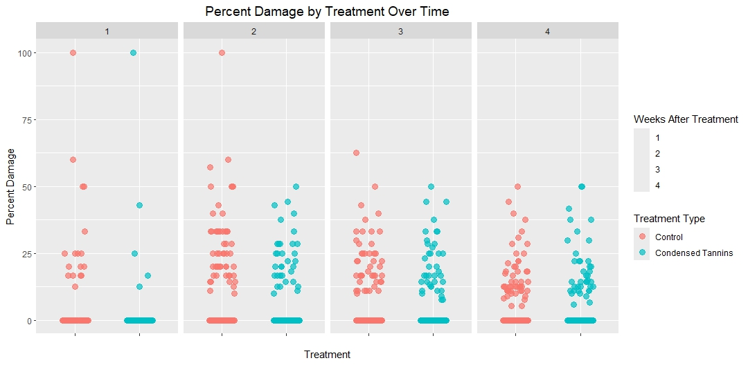
Field Evaluation of Condensed Tannins
as a White-Tailed Deer Repellent for Soybeans
Ethan Marburger¹, Dr. Rachel Vann¹, Dr. Guy Collins¹, Dr. Erin Schielp¹, Dr. Christopher S. DePerno¹
NC State University Department of Fisheries, Wildlife, and Conservation Biology
Background & Objectives
Visualizing the Data
Camera Photos
Crop losses to wildlife totaled $619 million with 48% of agricultural operations reported losses from wildlife damage
Damage by white-tailed deer exceeds $100 million annually
While repellents exist to deter depredation, many are ineffective and lack empirical evidence
Condensed tannins are a naturally occurring secondary metabolite used by plants as a defense mechanism against foraging
Researchers determined that 10% concentration of condensed quebracho tannins had a negative influence on intake rate and probability of consumption
Objectives: Evaluate the use of condensed tannins in a field setting to reduce or eliminate browsing by white-tailed deer on soybeans in North Carolina.
Methods
Field trials conducted on privately owned agriculture land near Black Creek, North Carolina, USA
Experimental plots (n = 20), approximately 0.20 ha, randomly assigned as treatment (n = 10) or control (n = 10)
Treated fields received a single application 10% condensed tannins and water on 06/21/24 between the V2-V3 growth stages.
Feeding behavior in plots was captured by cameras set to take 3-image-bursts every second triggered by movement.
Collected weekly measurements of soybean heigh (cm) and percent damage (total number of petioles (leaf stems) supporting leaves damaged by deer divided by total number of petioles on the plant) along transects in experimental plots
Acknowledgments
This project was supported by the NC Soybean Producers Association, Inc., the NC Agricultural Foundation, and the FWCB Program at NC State.
We would Like to thank David Blalock, NC State Extension, Norman Harrell, Triangle C.C., Maylee Holbrook, Courtland Aaron Hayes, Heather Moonier, and other volunteers.

